Slide 1
ART OF COMMUNICATION
TEAM NO: 2

Slide 2
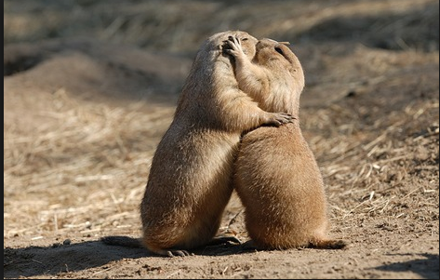
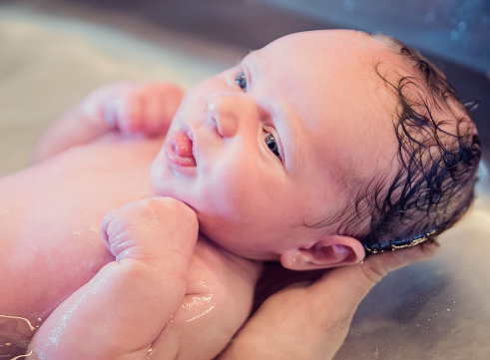
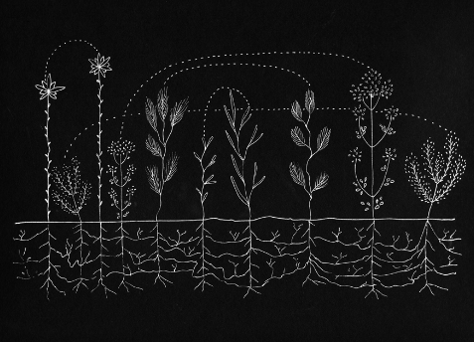
Communication (from Latin communicare, meaning "to share") is the act of conveying meanings from one entity or group to another through the use of mutually understood signs, symbols, and semiotic rules.
Communication goals:
To change behaviour
To get action
To persuade
To ensure understanding
To get and give informations

Slide 3
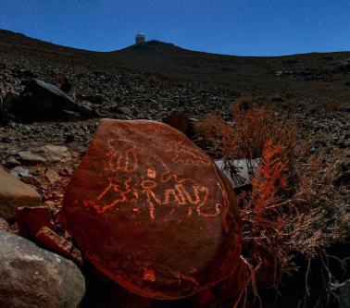
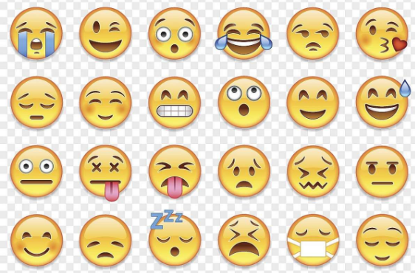
VERBAL COMMUNICATION
Verbal communication is the spoken or written conveyance of a message. Human language can be defined as a system of symbols (sometimes known as lexemes) and the grammars (rules) by which the symbols are manipulated.
Use simple language
Make sure that you are grammatically correct
Be clear and precise
1930 2019
Three information communication revolutions:
Pictograms
Paper ,papyrus ,clay ,wax
Electromagnetic radiation

Slide 4

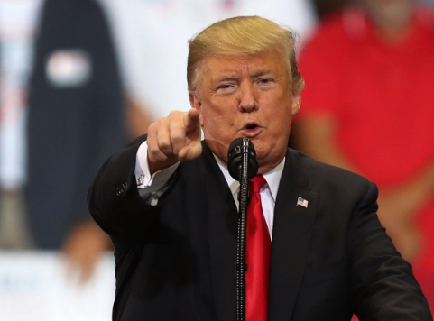
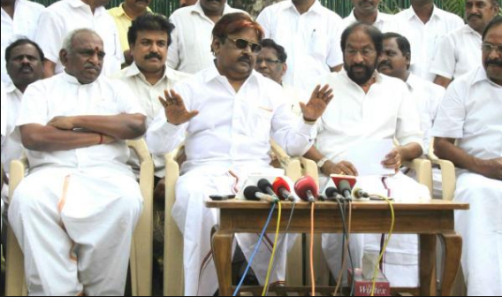
ORAL COMMUNICATION -> Oral communication is the process of expressing information or ideas by word of mouth. -> Oral communication can be either formal or informal. -> Examples of informal oral communication include: Face-to-face conversations Telephone conversations Discussions that take place at business meetings ->More formal types of oral communication include: Presentations at business meet Commencement speeches given at a graduation ceremony

Slide 5
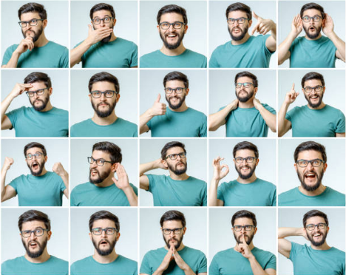
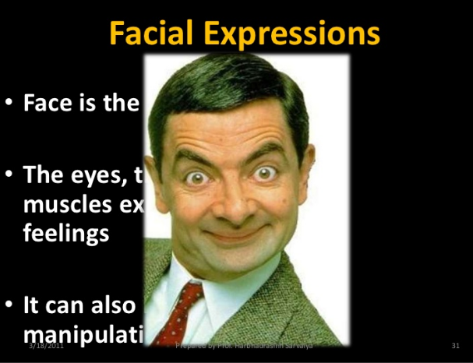
NON VERBAL COMMUNICATION
Nonverbal communication describes the processes of conveying a type of information in the form of non-linguistic representations. Examples of nonverbal communication include haptic communication, chronemic communication, gestures, body language, facial expressions, eye contact, and how one dresses.
FACIAL EXPRESSIONS:
-> Have a good smile-” SMILES HAVE MUSCLES- FAKE SMILES DON’T WORK”
-> Eye Contact- look sincerely and steadily at another person.

Slide 6
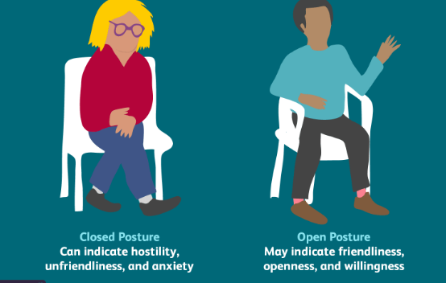
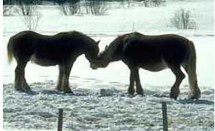
BODY LANGUAGE
Positive body language can also help you to engage people, to mask presentation nerves, and to project confidence when you speak in public.
Have a positive posture
Keep your head up
Practice and perfect your posture
Use open hand gestures
Most animals (including people) use “body language” as well as sound and smell in order to communicate with one another. Here are some of the ways animals express themselves.
Bees dance when they have found nectar.
Chimpanzees greet each other by touching hands.
Giraffes press their necks together when they are attracted to each other.
Horses rub noses as a sign of affection.

Slide 7

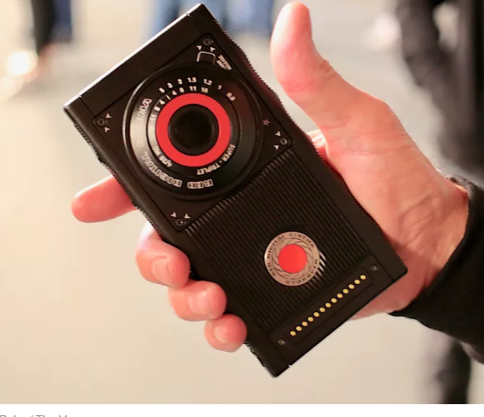
WHAT IS THIS ?

Slide 8
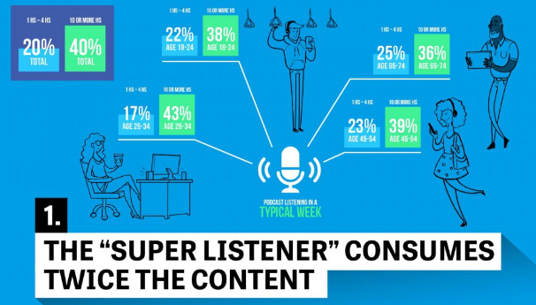

LISTENERS INVOLVEMENT
To maintain the active interest & involvement of each person with whom you are communicating, every time you talk to one person or one thousand
NINE TECHNIQUES:
Drama
Eye communication
Movement
Visuals
Questions
Demonstrations
Samples
Interest
Humour

Slide 9
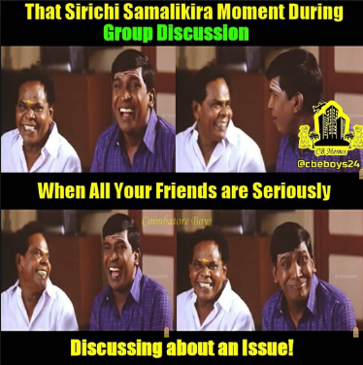
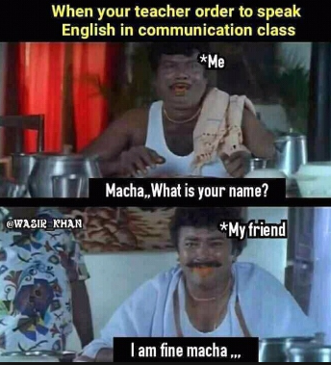
What happens when they lack ?

Slide 10
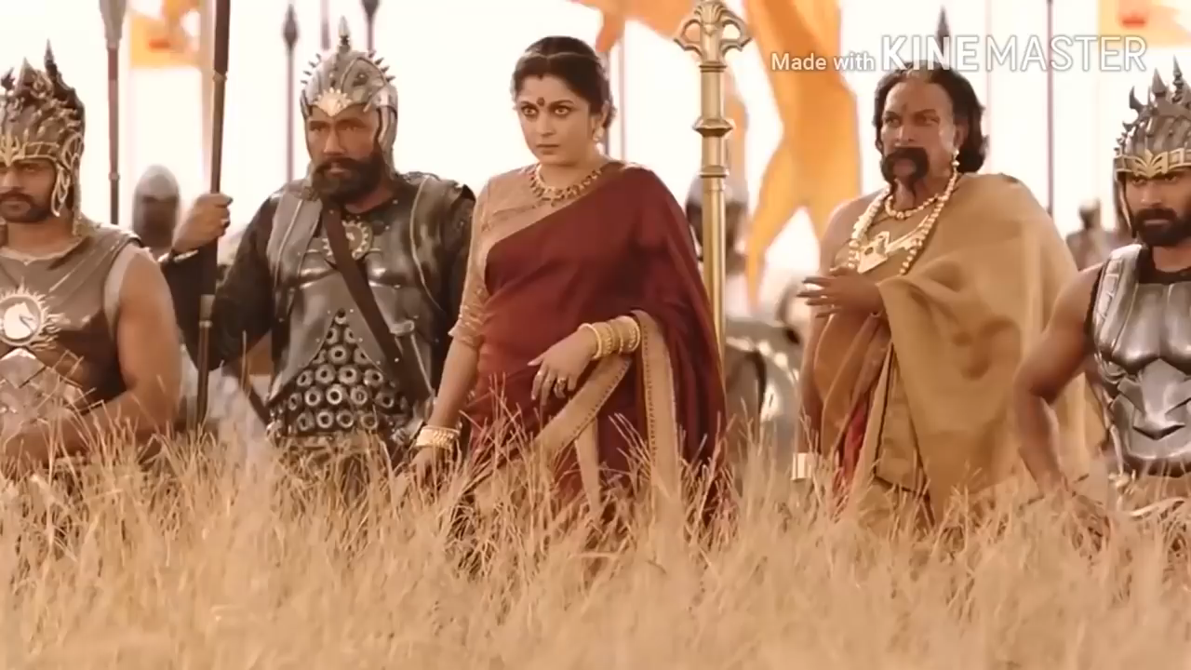

Slide 11
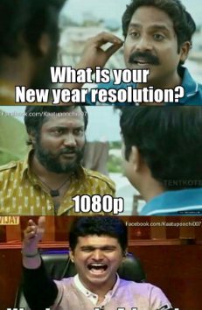
ANY QUERIES?

Slide 12
SUBMITTED BY
MADHUSREE V
KHARISRI T
POORNESH KUMAR G
HARI KRISHNAN S
KALISH SAI PRASAD M
SOUNDARYAN K
THANK YOU…

